Slide 1

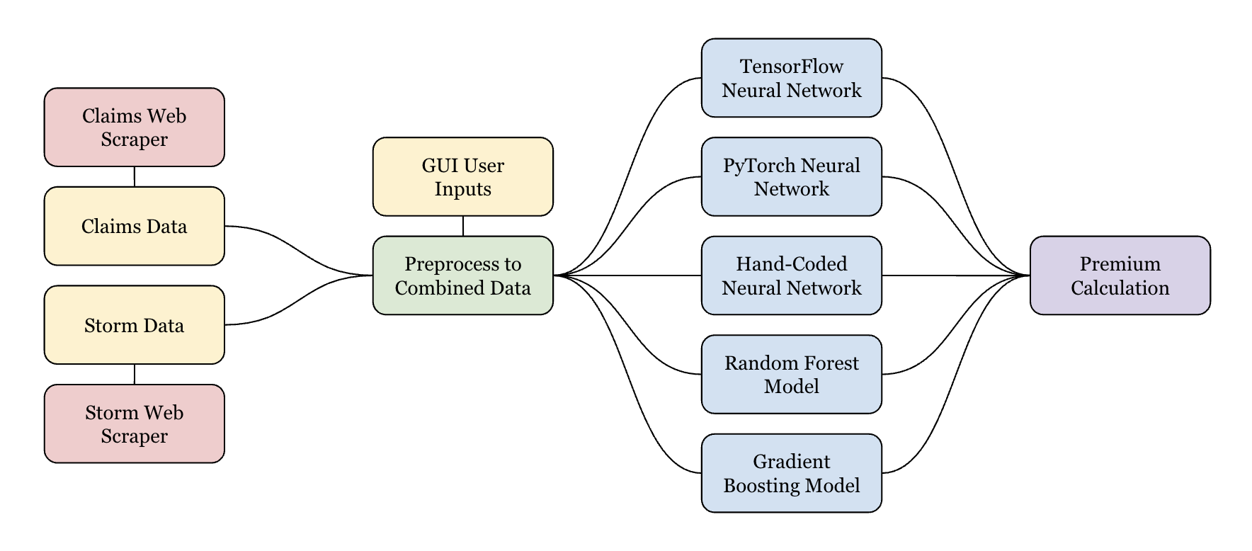
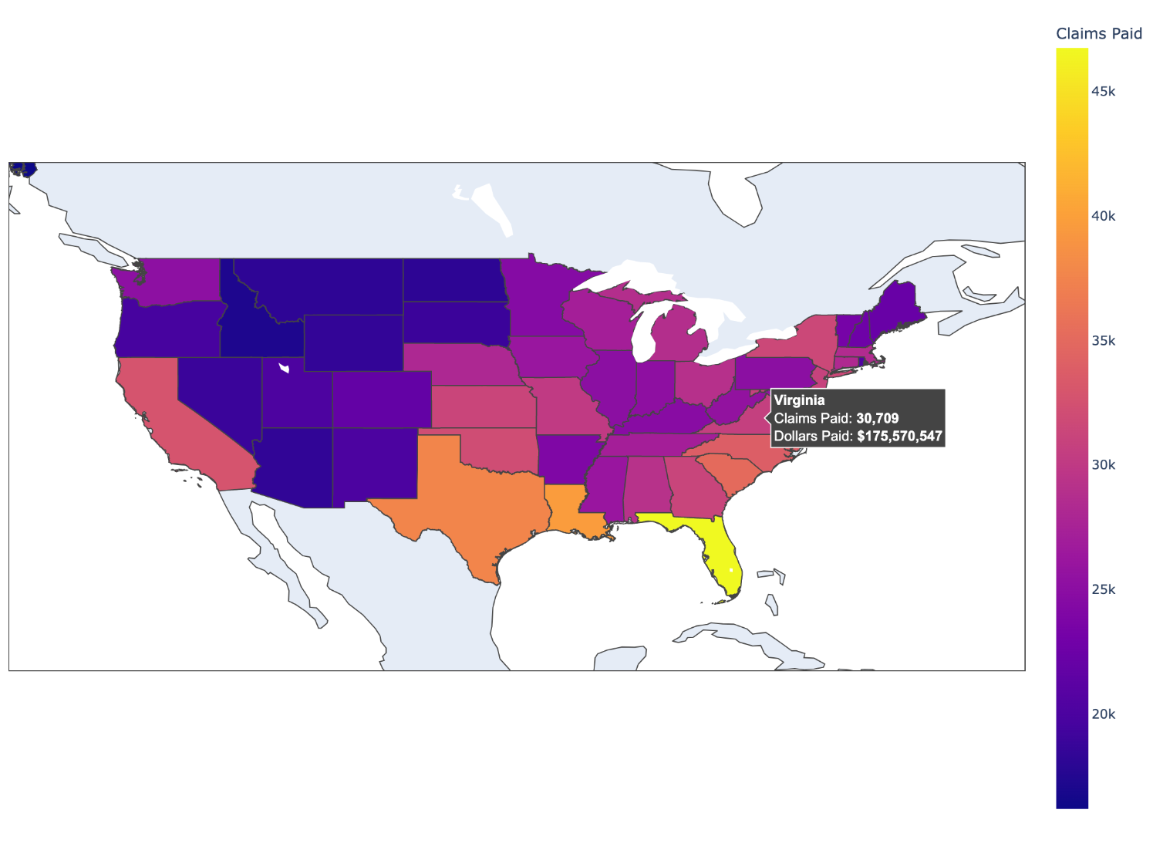
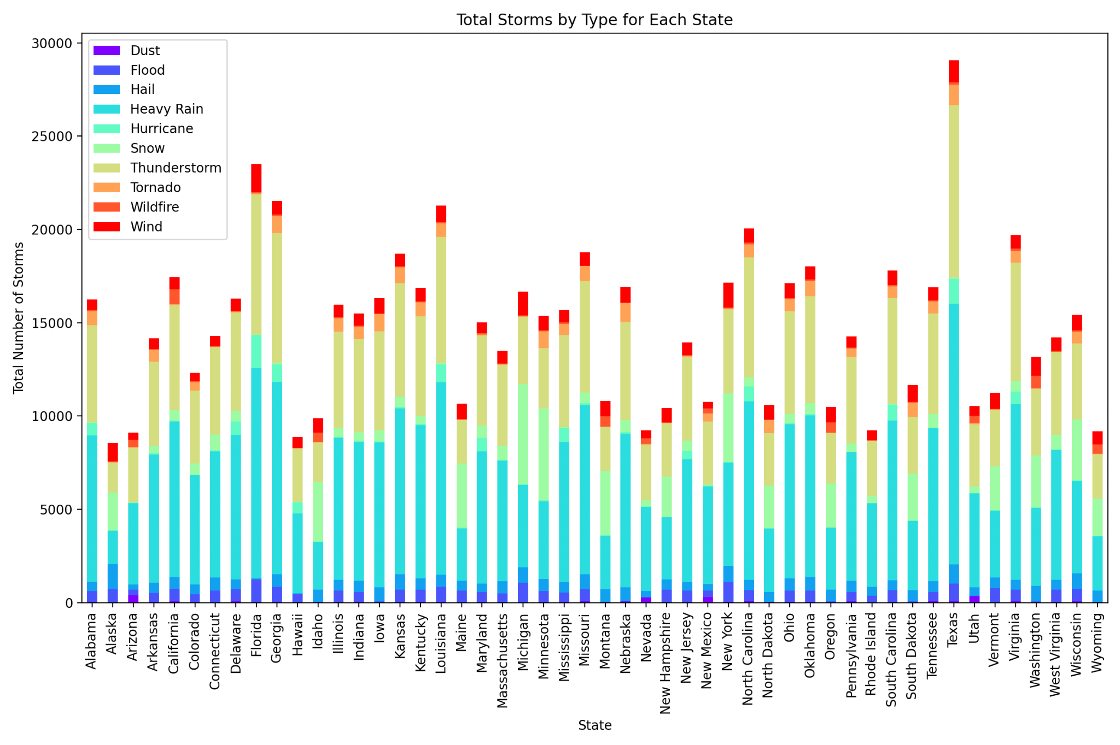
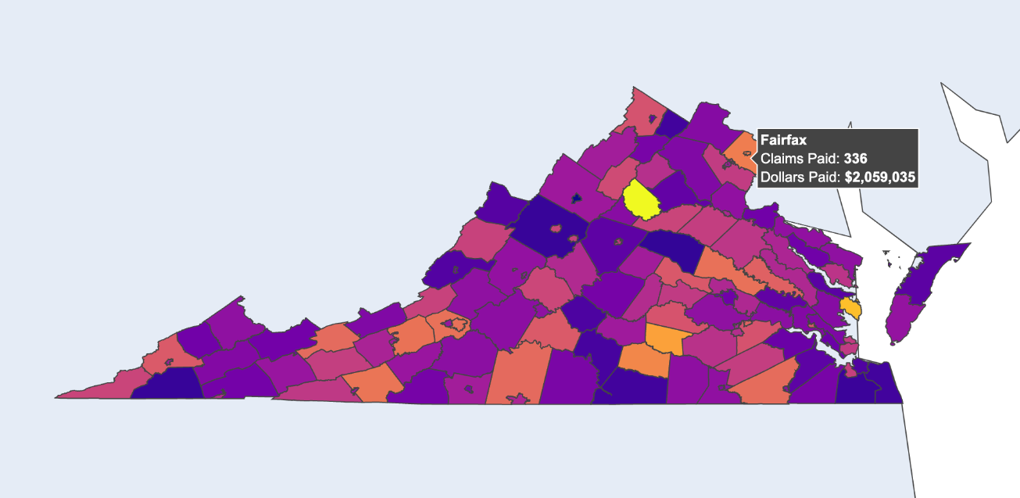
Dhruv Chandna &
Luke Flecker
TJHSST
Class of 2025
Computer
Systems Lab
Dr. Torbert &
Dr. Yilmaz
Calculating Home Insurance Premiums Through Climate Risk Assessment
Introduction & Novelty
Impact & Future Work
Home insurance premium calculations are stuck in the past—relying on outdated factors like credit score, age, and zip code, while ignoring the growing threat of extreme weather. As storms, floods, wildfires, and hurricanes become more frequent and severe, traditional models have failed to adapt, leading to over 300,000 premium-related complaints annually and exposing a major gap in fairness and transparency. ThunderQuote directly addresses this by integrating historical storm event data with established actuarial methods, creating a smarter, more responsive way to estimate premiums based on real-world risk. Unlike traditional systems that use either overly simplified metrics or expensive, outdated catastrophe models, ThunderQuote fuses local storm history with conventional risk factors to offer both accuracy and accessibility. Our transparent platform allows users—insurers and policyholders alike—to explore risk data down to the county level, making premium calculations clearer, fairer, and better suited for a climate-challenged future.
ThunderQuote fundamentally changes how insurers and customers interact with risk information. By providing location-specific premium estimates based on real storm history, we allow insurers to offer fairer, more data-driven policies, while giving customers a clear explanation of their rates. This increased transparency can reduce policyholder complaints, improve customer satisfaction, and save companies countless hours in disputes and re-evaluations. Furthermore, by highlighting environmental factors that traditional models ignore, ThunderQuote helps align the insurance industry with the realities of a changing climate. Moving forward, we aim to integrate live weather data feeds into the model to reflect ongoing storm activity, enhance the neural networks with additional training on more granular event types, and expand the premium calculation tool currently on the dashboard—allowing users to input more of their own information to receive more accurate premium estimates personalized to their risk profile.
Figure 2: Systems Architecture
Methods
ThunderQuote’s system architecture, shown in Figure 2, starts with a massive, carefully engineered data collection phase. Using custom Selenium-based web scrapers, we gathered thousands of individual insurance claim records and matched them with over 40 years of storm event data visualized in Figure 1. With over 15,400 clicks and more than 70MB of raw information spanning all 50 states, we constructed one of the most detailed combined datasets currently available for insurance risk modeling. Preprocessing involved aggressive data cleaning: normalizing storm types, de-duplicating events, and synchronizing records by year, state, and county to ensure consistency. From there, we trained a range of predictive models—including Random Forests, Gradient Boosted Trees, and both PyTorch and TensorFlow-based neural networks. Each model was evaluated for accuracy, with Pearson correlations guiding the feature selection to highlight which storm types most strongly predicted claims. On the frontend, we built a web application using Dash, Flask, and Plotly, allowing users to easily explore risk maps by clicking on states, zooming into counties, and seeing how storm events have historically impacted premiums.
Results
As shown in Figure 3, ThunderQuote’s dashboard offers a fast, clean experience where users can visualize claims and storm data from the national to county level. After login, users see claims, event counts, and risk scores overlaid on an interactive map. Performance metrics show the Random Forest model achieving an average error of around $1841 off per claim with a 12% error on our testing set (2024 data). The Gradient Boosting model’s average error was around $1529 off per claim with a 10% error on our testing set. Finally, our neural networks average error dropped to around $1237 off per claim with only an 8% error on the testing set. ThunderQuote’s multi-model strategy consistently beats traditional methods, delivering smarter premium estimates with real-world environmental context.
Figure 1: Visualizing the Number and Type of Storms by State
Figure 3: ThunderQuote Dashboard

